Slide 1
Problem Statement
Vehicle Cut-in Detection
To develop a sophisticated detection system capable of identifying potential vehicle collisions and issuing immediate warnings using advanced machine learning algorithms and computer vision techniques

Slide 2
Unique Idea Brief (Solution)
This project introduces an innovative approach to vehicle cut-in detection Leveraging the YOLOv5 model, it ensures precise and efficient real-time vehicle detection. The system processes a video file input by converting it into frames. In each frame, the model calculates the distance between vehicles, detecting potential cut-ins when distances are critically close, and subsequently issues warnings as necessary. It significantly employs machine learning algorithms to fine tune the model and computer vision for detecting the vehicles.

Slide 3
Features Offered
Lane Detection: Uses edge detection and line drawing techniques to identify lane lines on the road.
Cut-In Detection: Identifies and highlights instances where vehicles cut into lanes, generating warnings.
Vehicle Detection: Utilizes the YOLOv5 model to detect vehicles such as cars, buses, trucks, motorcycles, scooties, and bikes.
Collision Warning: Calculates the distance between vehicles and issues warnings if they are too close to each other.

Slide 4
Features Offered
Performance Evaluation: Measures precision, recall, and F1 score for the detection algorithm using ground truth data.
Video Processing: Outputs a processed video with highlighted detections and warnings.
Distance Measurement: Measures the Euclidean distance between the centers of detected vehicles to assess proximity.
Vehicle Counting: Counts the number of vehicles detected in the video frames.
Vehicle Tracking: Tracks detected vehicles across video frames to maintain consistent identification.

Slide 5
Process flow
1. Collecting the required dataset
Link of the dataset : https://www.kaggle.com/datasets/pkdarabi/vehicle-detection-image-dataset
2. Fine-tune the model
Re-encode Video: Ensures the input video is in a suitable format for processing.
Read Ground Truth Data: Loads ground truth vehicle locations from a CSV file for performance evaluation.

Slide 6
Process flow
Process Video Frames: Splits the video into frames and processes each frame using the vehicle detection and tracking pipeline.
Detection and Evaluation: Detects vehicles, tracks their positions, evaluates detection performance, and calculates precision, recall, and F1 score.
Highlight and Warn: Highlights detected vehicle areas, checks for cut-in scenarios, and adds warning messages to the video.
Output Processed Video: Saves the final processed video with all detections and warnings.

Slide 7
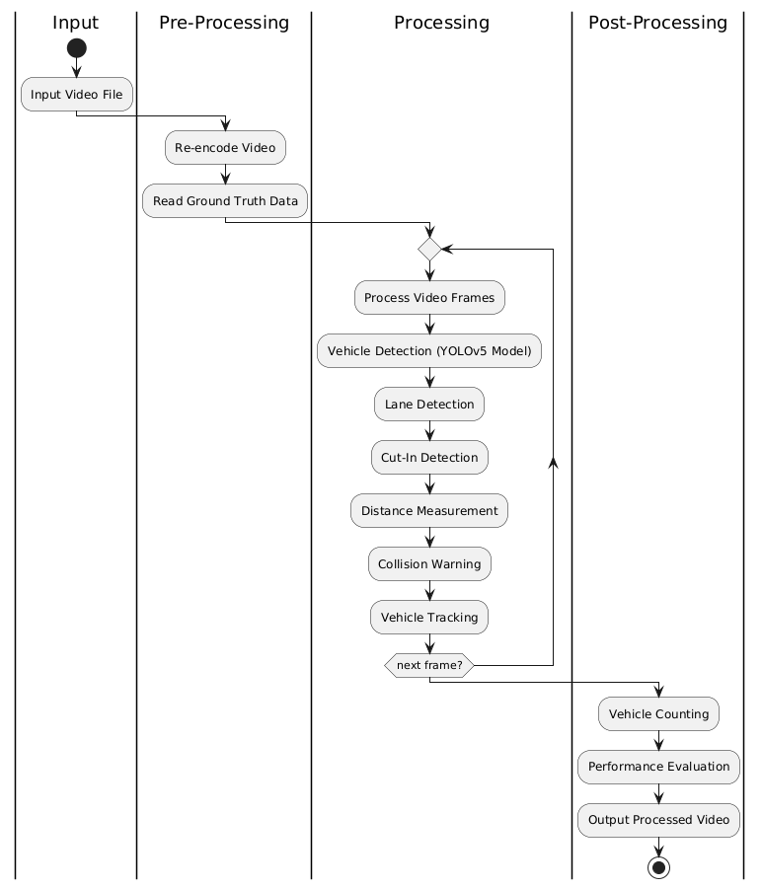
Architecture Diagram

Slide 8
Technologies used
Python: For scripting and implementation.
OpenCV: For video processing and image manipulation.
YOLOv5: For vehicle detection.
MoviePy: For video handling and output.
NumPy: For numerical operations.
Pandas: For reading and handling CSV data.
PyTorch: For loading the YOLOv5 model.
Subprocess: For running FFmpeg commands.

Slide 9
Conclusion
In conclusion, this project has developed an advanced detection system using cutting-edge machine learning and computer vision techniques. Leveraging the YOLOv5 model, it ensures precise real-time vehicle detection and identifies potential cut-in scenarios with critical proximity warnings. By integrating lane detection and vehicle classification capabilities, the system enhances safety by accurately assessing collision risks and issuing timely alerts. Through rigorous model fine-tuning, comprehensive evaluation processes, and efficient video processing, it delivers a robust solution for proactive vehicle safety management on the road.

